Slide 1
Digital Logic and Design
Design a Mod-12 Asynchronous Counter using JK Flip Flop
19115045
KUNAL SACHDEVA
3rd Semester CSE

Slide 2
Counters
A counter is a device which stores (and sometimes displays) the number of times a particular event or process has occurred, often in relationship to a clock.
Counters are of two types:
•Synchronous counters
•Asynchronous or ripple counters
In Asynchronous counter:
•Different flip flops are triggered with different clock, not simultaneously.
•It is slower than synchronous counter in operation.
•It’s designing as well as implementation is very easy.
•It has high propagation delay.

Slide 3
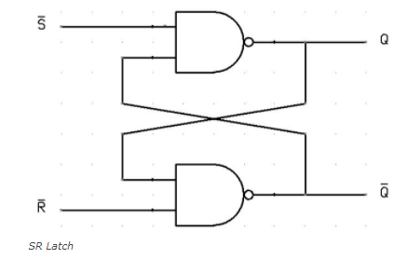
Flip-flops and Latches
•A flip flop is an electronic circuit with two stable states that can be used to store binary data. The stored data can be changed by applying varying inputs.
•Flip-flops and latches are fundamental building blocks of digital electronics systems used in computers, communications, and many other types of systems.
•Flip-flops and latches are used as data storage elements. It is the basic storage element in sequential logic. But first, let’s clarify the difference between a latch and a flip-flop.
SR Latch Circuit

Slide 4
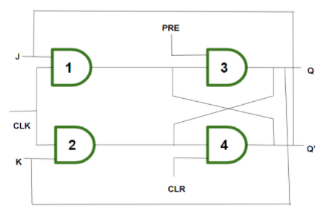
JK Flip Flop
•The JK flip flop is an improvement on the SR flip flop where S=R=1 is not a problem.
•The input condition of J=K=1, gives an output inverting the output state. However, the outputs are the same when one tests the circuit practically.
•If J and K data input are different (i.e. high and low) then the output Q takes the value of J at the next clock edge. If J and K are both low then no change occurs. If J and K are both high at the clock edge then the output will toggle from one state to the other. JK Flip Flop can function as Set or Reset Flip flop.

Slide 5
Truth Table:
C=𝚺m(12)+𝚺d(13,14,15)
Clock Pulse | Qd | Qc | Qb | Qa | Decimal Equivalent | Clear
0 | 0 | 0 | 0 | 0 | 0 | 0
1 | 0 | 0 | 0 | 1 | 1 | 0
2 | 0 | 0 | 1 | 0 | 2 | 0
3 | 0 | 0 | 1 | 1 | 3 | 0
4 | 0 | 1 | 0 | 0 | 4 | 0
5 | 0 | 1 | 0 | 1 | 5 | 0
6 | 0 | 1 | 1 | 0 | 6 | 0
7 | 0 | 1 | 1 | 1 | 7 | 0
8 | 1 | 0 | 0 | 0 | 8 | 0
9 | 1 | 0 | 0 | 1 | 9 | 0
10 | 1 | 0 | 1 | 0 | 10 | 0
11 | 1 | 0 | 1 | 1 | 11 | 0
12 | 0 | 0 | 0 | 0 | 0 | 1
K-Map of Clear:
Qa Qb
12 States
MOD-12
Qc Qd
 | 00 | 01 | 11 | 10
00
01
11 | 1 | x | x | x
10
C=QcQd
Reset Condition:

Slide 6
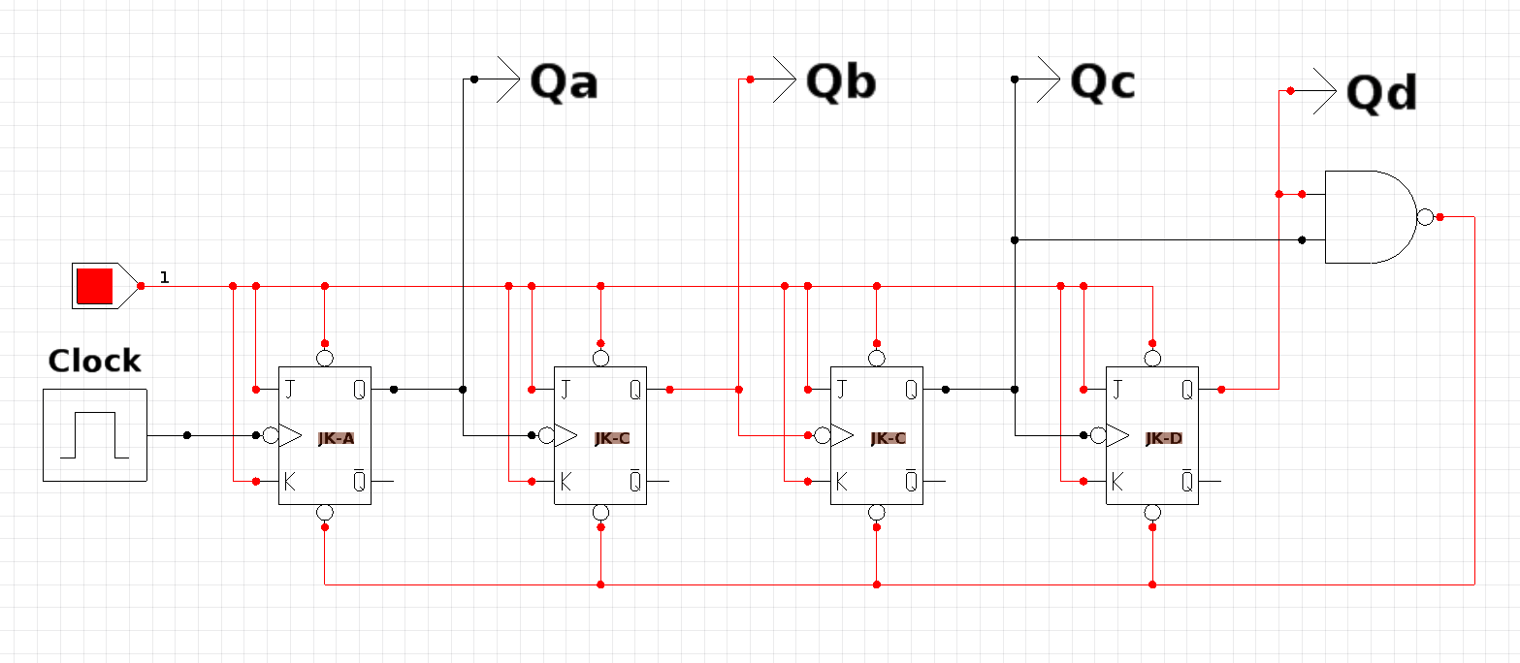
Circuit Diagram
Using CEDAR Logic Simulator

